Slide 1
Binary and Other Trees

Slide 2
Linear Lists and Trees
Linear lists are useful for serially ordered data
(e₁,e₂,e₃,…,e_{n})
Days of week
Months in a year
Students in a class
Trees are useful for hierarchically ordered data
Joe’s descendants
Corporate structure
Government Subdivisions
Software structure

Slide 3
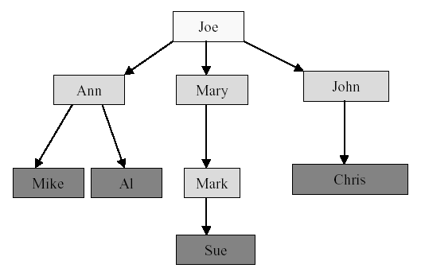
Joe’s Descendants
What are other examples of hierarchically ordered data?

Slide 4
Definition of Tree
A tree t is a finite nonempty set of elements
One of these elements is called the root
The remaining elements, if any, are partitioned into trees, which are called the subtrees of t.

Slide 5
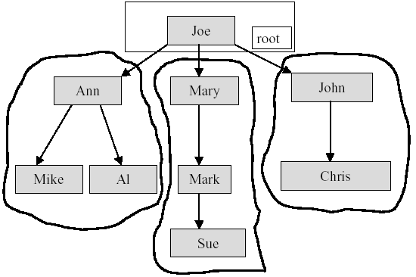
Subtrees

Slide 6
Tree Terminology
The element at the top of the hierarchy is the root.
Elements next in the hierarchy are the children of the root.
Elements next in the hierarchy are the grandchildren of the root, and so on.
Elements at the lowest level of the hierarchy are the leaves.

Slide 7
Other Definitions
Leaves, Parent, Grandparent, Siblings, Ancestors, Descendents
Leaves = {Mike,AI,Sue,Chris}
Parent(Mary) = Joe
Grandparent(Sue) = Mary
Siblings(Mary) = {Ann,John}
Ancestors(Mike) = {Ann,Joe}
Descendents(Mary)={Mark,Sue}

Slide 8
Levels and Height
Root is at level 0 and its children are at level 1.
depth = number of levels
Height=number of edges on the longest path from the node to a leaf.
level 0
level 1
level 2
level 3

Slide 9
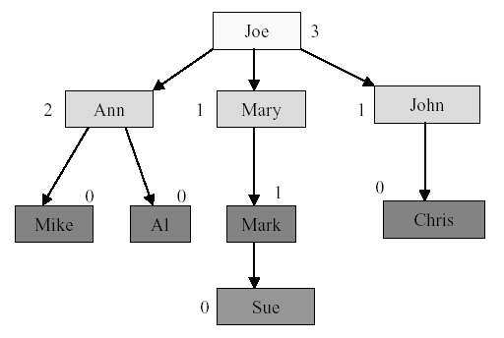
Node Degree
Node degree is the number of children it has

Slide 10
Tree Degree
Tree degree is the maximum of node degrees
tree degree = 3

Slide 11
Binary Tree
A finite (possibly empty) collection of elements
A nonempty binary tree has a root element and the remaining elements (if any) are partitioned into two binary trees
They are called the left and right subtrees of the binary tree

Slide 12
Difference Between a Tree & a Binary Tree
A binary tree may be empty; a tree cannot be empty.
No node in a binary tree may have a degree more than 2, whereas there is no limit on the degree of a node in a tree.

Slide 13
Binary Tree Properties
The drawing of every binary tree with n elements, n > 0, has exactly n-1 edges.
A binary tree of height h, h >= 0, has at least h and at most 2^{h+1}-1 elements in it.

Slide 14
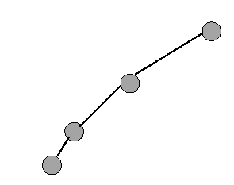
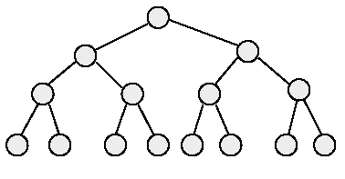
Binary Tree Properties
The height of a binary tree that contains n elements, n >= 0, is at least ⎡(log₂(n-1))⎤ and at most n-1
minimum number of elements
maximum number of elements

Slide 15
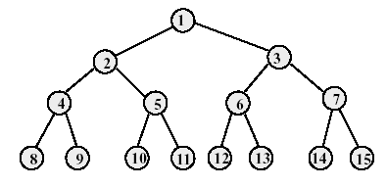
Full Binary Tree
A full binary tree of height h has exactly 2^{h+1}-1 nodes.
Numbering the nodes in a full binary tree
Number the nodes 1 through 2^{h+1}-1
Number by levels from top to bottom
Within a level, number from left to right

Slide 16

Node Number Property of Full Binary Tree
Parent of node i is node ⎣(i/2)⎦, unless i = 1
Node 1 is the root and has no parent

Slide 17
Node Number Property of Full Binary Tree
Left child of node i is node 2i, unless 2i > n, where n is the total number of nodes.
If 2i > n, node i has no left child.

Slide 18
Node Number Property of Full Binary Tree
Right child of node i is node 2i+1, unless 2i+1 > n, where n is the total number of nodes.
If 2i+1 > n, node i has no right child.

Slide 19
Complete Binary Tree with N Nodes
Start with a full binary tree that has at least n nodes
Number the nodes as described earlier.
The binary tree defined by the nodes numbered 1 through n is the n-node complete binary tree.
A full binary tree is a special case of a complete binary tree

Slide 20
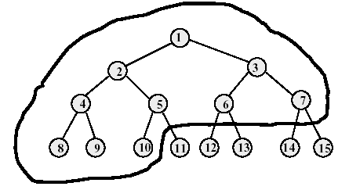
Example of Complete Binary Tree
Complete binary tree with 10 nodes.
Same node number properties (as in full binary tree) also hold here.

Slide 21
Binary Tree Representation
Array representation
Linked representation

Slide 22
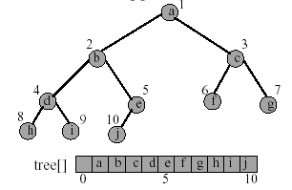
Array Representation of Binary Tree
The binary tree is represented in an array by storing each element at the array position corresponding to the number assigned to it.

Slide 23
Linked Representation of Binary Tree
The most popular way to present a binary tree
Each element is represented by a node that has two link fields (leftChild and rightChild) plus an element field.
Each binary tree node is represented as an object whose data type is binaryTreeNode.
The space required by an n node binary tree is n * sizeof(binaryTreeNode)

Slide 24
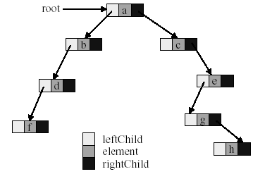
Linked Representation of Binary Tree

Slide 25
Common Binary Tree Operations
Determine the height
Determine the number of nodes
Make a copy
Determine if two binary trees are identical
Display the binary tree
Delete a tree
If it is an expression tree, evaluate the expression
If it is an expression tree, obtain the parenthesized form of the expression

Slide 26
Binary Tree Traversal
Many binary tree operations are done by performing a traversal of the binary tree
In a traversal, each element of the binary tree is visited exactly once
During the visit of an element, all actions (make a copy, display, evaluate the operator, etc.) with respect to this element are taken

Slide 27
Binary Tree Traversal Methods
Preorder
The root of the subtree is processed first before going into the left then right subtree (root, left, right).
Inorder
After the complete processing of the left subtree the root is processed followed by the processing of the complete right subtree (left, root, right).
Postorder
The root is processed only after the complete processing of the left and right subtree (left, right, root).
Level order
The tree is processed by levels. So first all nodes on level i are processed from left to right before the first node of level i+1 is visited

Slide 28
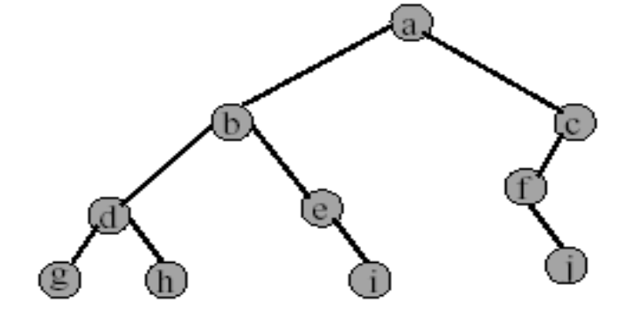
Preorder Example (visit = print)
a b d g h e i c f j

Slide 29
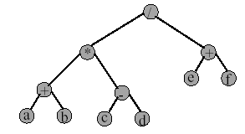
Preorder of Expression Tree
/ * + a b - c d + e f
Gives prefix form of expression.

Slide 30
Inorder Example (visit = print)
g d h b e i a f j c

Slide 31
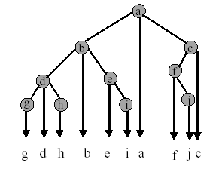
Inorder by Projection (Squishing)

Slide 32
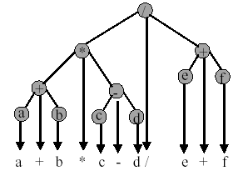
Inorder of Expression Tree
Gives infix form of expression, which is how we normally write math expressions.

Slide 33
Postorder Example (visit = print)
g h d i e b j f c a

Slide 34
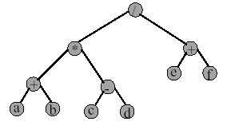
Postorder of Expression Tree
a b + c d - * e f + /
Gives postfix form of expression.

Slide 35
Level Order Example (visit = print)
Add and delete nodes from a queue
Output: a b c d e f g h i j

Slide 36
Space and Time Complexity
The space complexity of each of the four traversal algorithm is O(n)
The time complexity of each of the four traversal algorithm is Θ(n)

